Slide 1

Predictive modelling of heating and cooling loads in building design using machine learning
Team members:
Akash appari
Mohammed razin kattassery anwar
Roshan sasi

Slide 2
contents
INTRODUCTION
PROBLEM STATEMENT
BACKGROUND AND RELATED WORK
RESEARCH APPROACH
DATA PIPELINE IN BUILDING ENERGY APPROACH
DATA COLLECTION
DATA PREPERATION- CLEANING AND PREPROCESSING
EXPLORATORY FACTOR ANALYSIS
1. Univariate Analysis through Histograms
2. Bivariate Analysis through Scatter Plots
3. Correlation Analysis
DATA PREPARATION
MODEL PLANNING
MODEL BUILDING
LIMITATIONS & FUTURE DIRECTIONS
FINDINGS
OPERATIONALIZATION

Slide 3

introduction
AI refers to the development of computer systems capable of performing tasks that typically require human intelligence, including:
Speech recognition
Problem-solving
Planning
Decision-making
Buildings are major contributors to global energy consumption, particularly in heating and cooling.
Accurate prediction and management of energy loads are crucial for sustainable architecture.
Machine learning (ML) provides an innovative approach for precise energy load predictions.

Slide 4

Problem statement
Accurate prediction of heating and cooling loads challenging due to variability in designs and factors influencing energy consumption.
Traditional methods may not capture nuances of modern designs.
ML in building science offers opportunities, but selecting appropriate models is crucial.
Project aims to identify effective ML models for accurate predictions.

Slide 5
Background and Related Work
Building design's impact on energy consumption.
Sustainable practices in architecture and construction.
ML's potential in uncovering energy-saving opportunities.
Challenges: Model selection, data quality, computational resources.

Slide 6

Research Approach
Comparative approach: Linear Regression, Decision Trees, Random Forest, Gradient Boosting, and Support Vector Regression.
Comprehensive data preprocessing, model training, and validation.
Primary evaluation criterion: Accuracy in predicting heating and cooling loads.
Understanding strengths and limitations of each model in real-world architectural design.

Slide 7
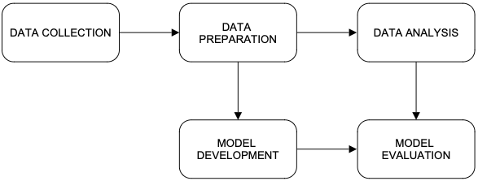
Data Pipelines in Building Energy Research
Systematic process involving data collection, preparation, analysis, and modeling.
Stages explained: Data collection, data preparation, data analysis, model development, model evaluation.
Figure 1: Data Pipeline for Predictive Modeling of Heating and Cooling Loads.
Figure 1

Slide 8

Data Collection: Gathering data relevant to building design and energy loads.
Data Preparation: Preprocessing the data, which includes cleaning, feature engineering, encoding, and splitting.
Data Analysis: Performing exploratory data analysis to understand the data's characteristics and patterns.
Model Development: Constructing and training machine learning models suitable for predicting heating and cooling loads.
Model Evaluation: Testing the models to assess their performance and accuracy.

Slide 9
Data Collection
Dataset sourced from UCI Machine Learning Repository, "Energy Efficiency" dataset by Tsanas and Xifara (2012).
Eight building design parameters and two energy efficiency measures: heating and cooling loads.
Key variables explained: relative compactness, surface area, wall area, roof area, overall height, orientation, glazing area, glazing area distribution.

Slide 10

The key variables in the dataset are as follows:
• Relative Compactness (X1): A measure of the building's compactness, which affects its thermal efficiency.
• Surface Area (X2): The total external area of the building.
• Wall Area (X3): The area covered by the walls.
• Roof Area (X4): The area of the building's roof, a critical factor in heat loss and gain.
• Overall Height (X5): The total height of the building, impacting the volume of space to be heated or cooled.
• Orientation (X6): The building’s orientation, influencing its solar exposure.
• Glazing Area (X7): The area covered by glass, which affects both light entry and thermal regulation.
• Glazing Area Distribution (X8): Describes how the glazing areas are distributed across the building.
The dataset's target variables are the Heating Load (Y1) and the Cooling Load (Y2).

Slide 11

Data Preparation - Cleaning and Preprocessing
Dataset pre-cleaned by Tsanas and Xifara (2012), ensuring high data quality.
Descriptive statistics (Figure 3) provide insights into the distribution and variability of design parameters and energy efficiency measures.
No missing values in the dataset (Figure 2).

Slide 12
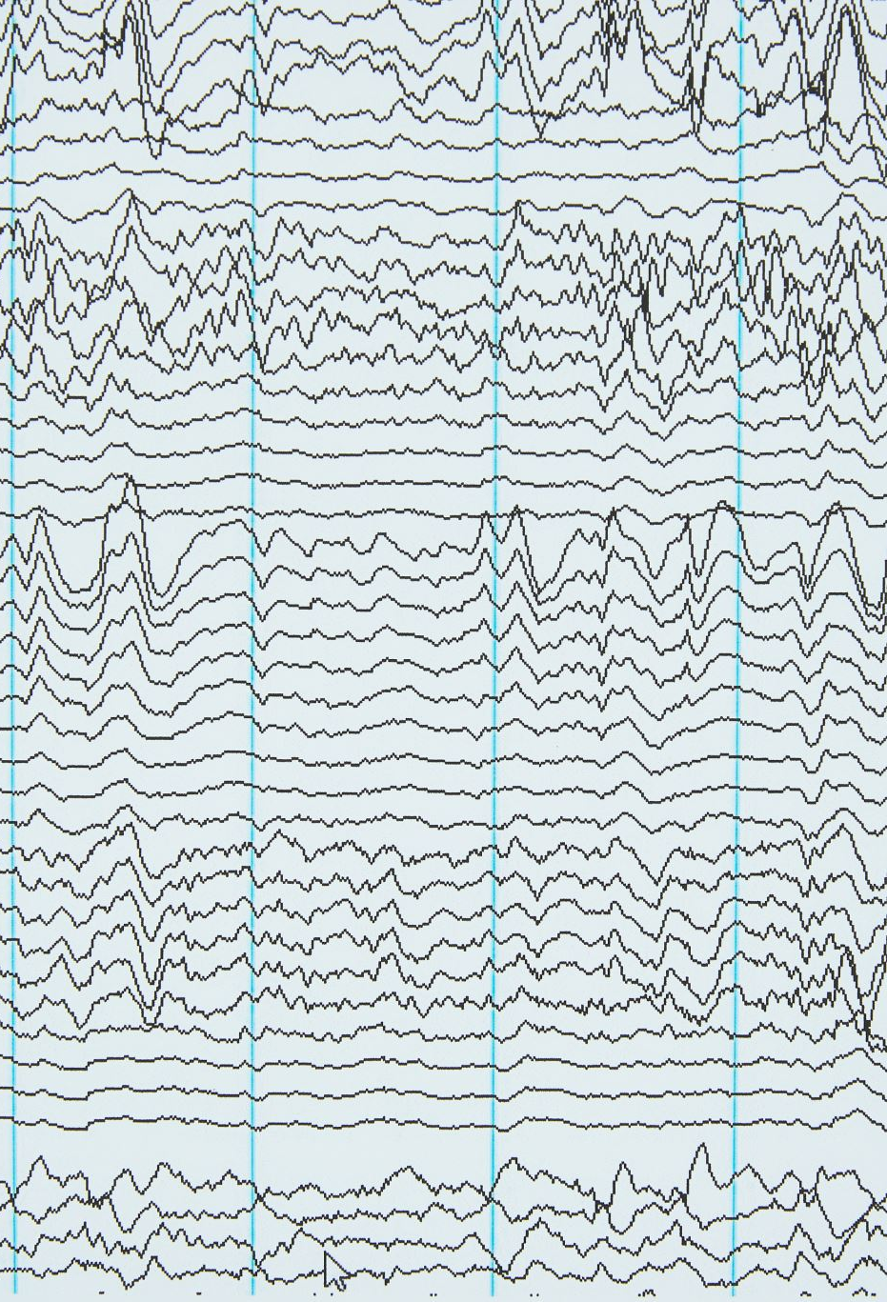
Exploratory factor analysis
Univariate analysis through histograms
Bivariate analysis through scatter plots
Correlation analysis using heatmap

Slide 13
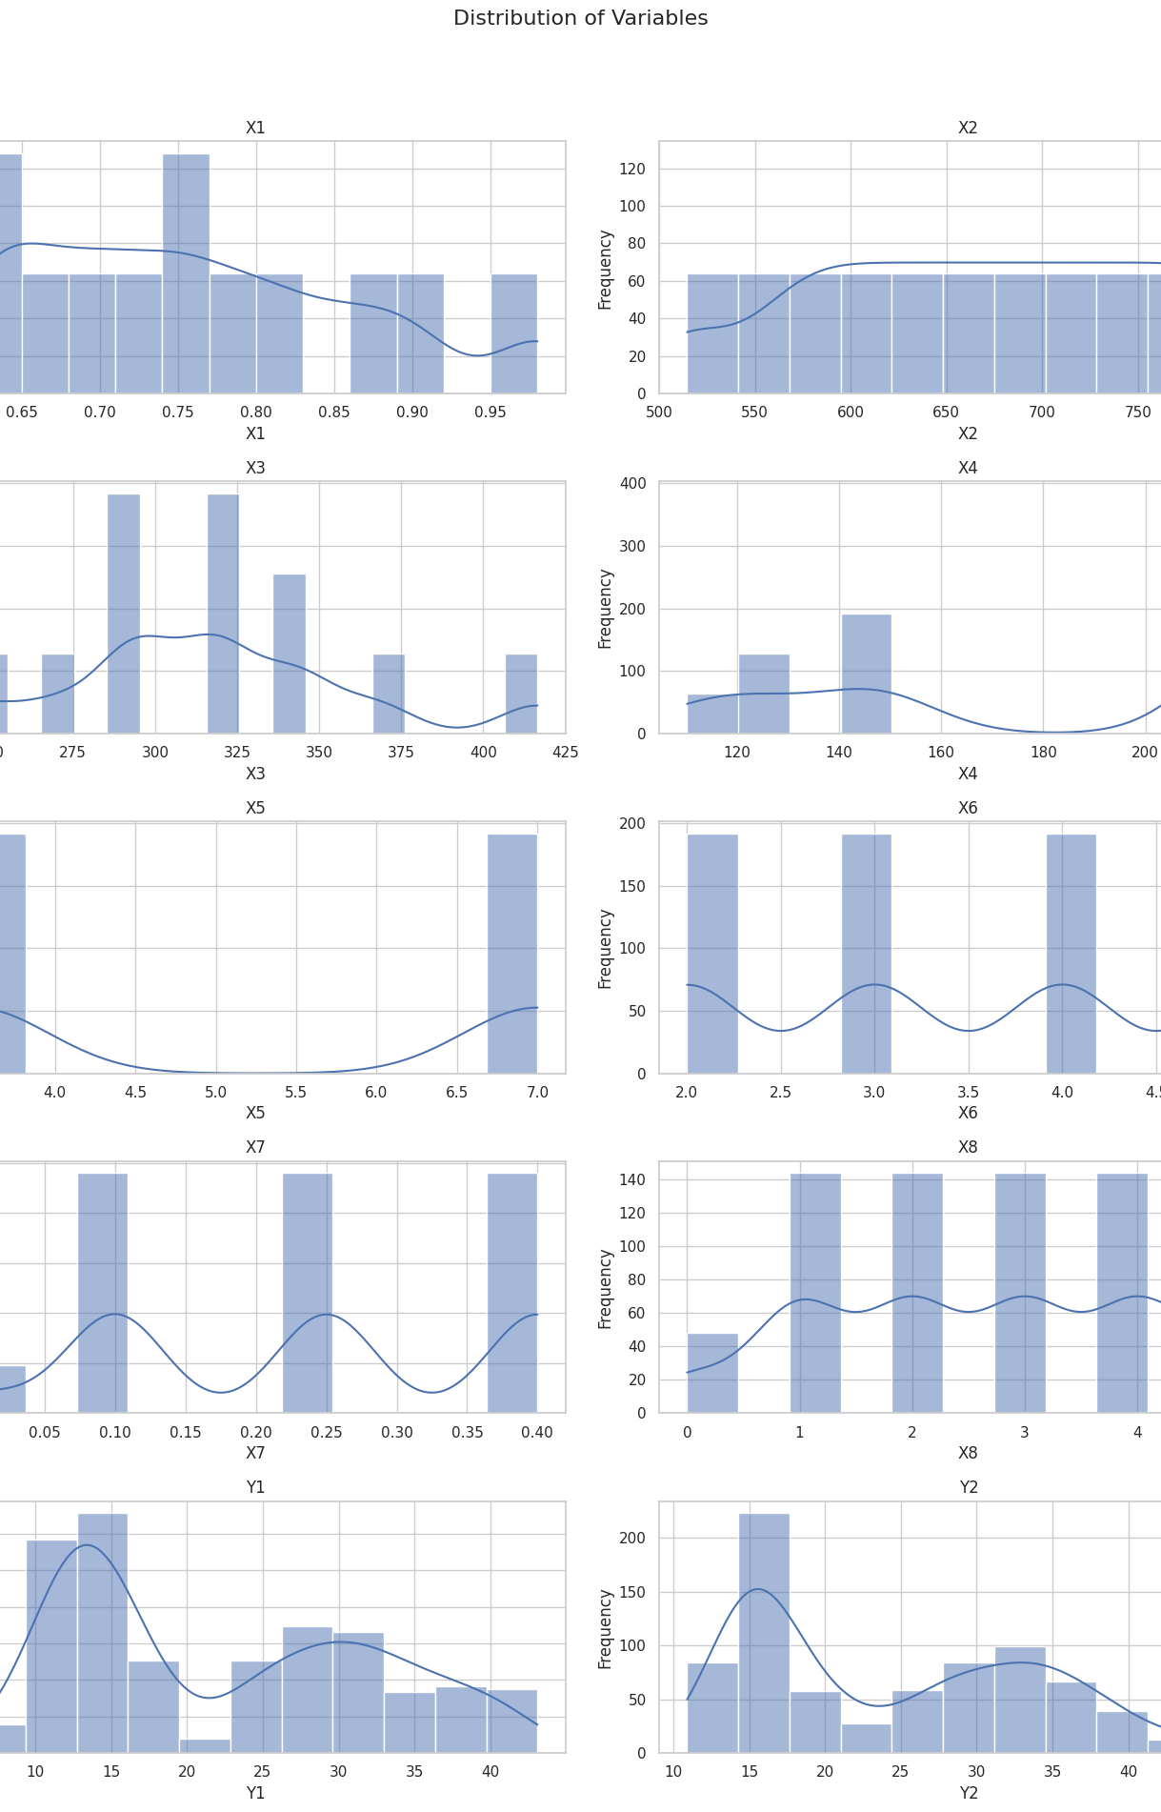
Univariate Analysis through Histograms
Objective: Understand the distribution of each building design parameter and energy efficiency measure individually.
Method: Histograms visually represent the frequency distribution of each variable.
Key Observations:
Identifies patterns, central tendency, and variability.
Provides insights into the nature of data distribution.

Slide 14
Bivariate Analysis through Scatter Plots
Objective: Examine the relationships between each design parameter and heating/cooling loads.
Method: Scatter plots illustrate how two variables vary together.
Key Observations:
Identifies trends, patterns, and potential correlations.
Helps understand how changes in one variable relate to changes in another.

Slide 15
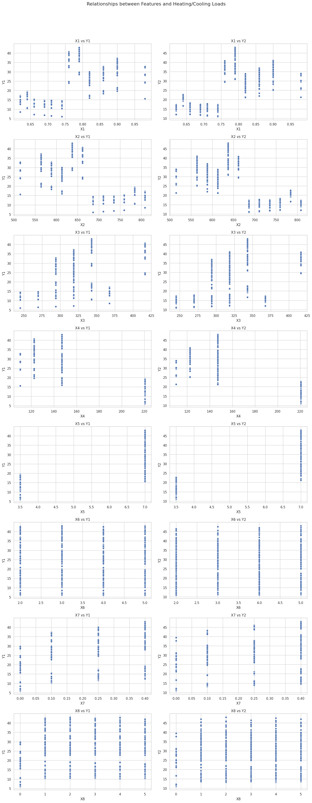
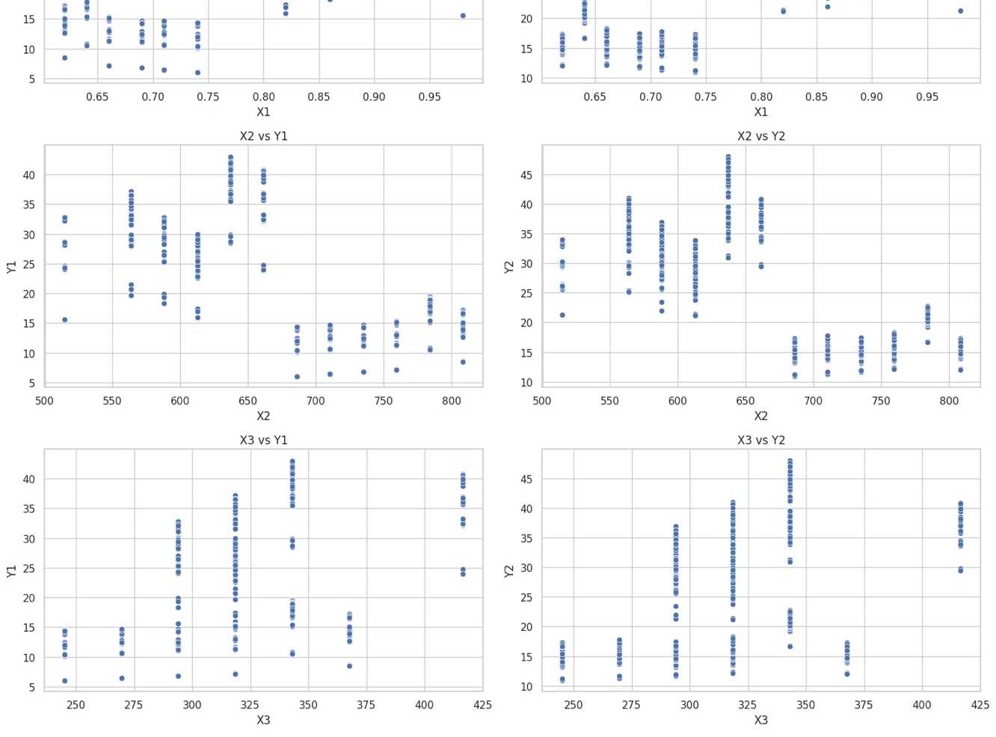
Relative Compactness (X1), Overall Height (X5), and Glazing Area (X7) show clear trends with the heating and cooling loads, suggesting a strong influence on energy requirements.
Surface Area (X2), Wall Area (X3), and Roof Area (X4) exhibit more complex relationships with Y1 and Y2, with multiple groupings indicating possible interactions with other variables.
The Orientation (X6) doesn't show a clear linear relationship with either heating or cooling loads, suggesting its influence might be less significant or more nuanced.
The Glazing Area Distribution (X8) also presents a complex pattern, indicating that its impact on energy loads might depend on other factors.

Slide 16
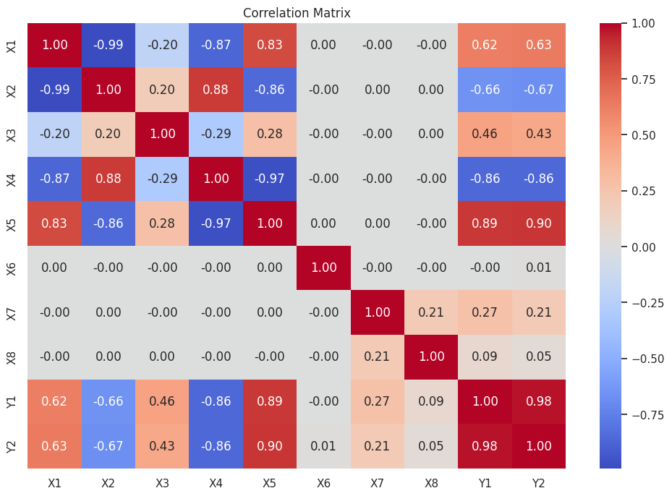
Correlation Analysis using Heatmap :
High Correlation with Heating and Cooling Loads (Y1, Y2): Some features exhibit strong correlations with the heating and cooling loads. For instance, Overall Height (X5), Relative Compactness (X1), and Glazing Area (X7) show significant correlations, indicating their strong influence on the energy requirements of the buildings.
Negative Correlation: Features like Surface Area (X2) and Roof Area (X4) show negative correlations with Y1 and Y2, suggesting that as these areas increase, the heating and cooling loads tend to decrease.
Inter-correlations among Features: There are strong correlations between some of the features themselves, such as between Relative Compactness (X1) and Surface Area (X2), and between Surface Area (X2) and Roof Area (X4). This indicates potential multicollinearity, which could impact the performance of certain machine learning models.
Orientation (X6) has low correlation coefficients with Y1 and Y2, supporting the earlier observation from the scatter plots.

Slide 17
Data preparation
For building the classification model, the dataset is split into training and testing sets. Feature selection is carried out to identify the most relevant variables that influence the energy efficiency of buildings.
SCALING:
StandardScaler from the scikit-learn library was employed.
Standardization involves removing the mean and scaling to unit variance.
Formula: 𝑧=(𝑥−𝑢)/𝑠, where z is the standardized value, x is the original value, u is the mean, and s is the standard deviation.
Dataset split into independent features (X) and dependent variables (Y1 and Y2 for heating and cooling loads).
Further division into training and testing sets with a 70-30 split.
StandardScaler fitted only on the training data to prevent information leakage into the model training process.

Slide 18
Model Planning
aimed to select and evaluate a diverse set of machine learning algorithms to identify the most effective model for predicting heating and cooling loads in buildings.
The chosen models are:
Linear Regression: A baseline model providing a simple linear approach to regression.
Decision Tree Regressor: Offers a more complex, non-linear approach and helps understand feature importance.
Random Forest Regressor: An ensemble model that builds multiple decision trees and merges them for a more accurate and stable prediction.
Gradient Boosting Regressor: An advanced ensemble technique that combines several weak models to create a strong predictive model.
Support Vector Regression (SVR): A different approach using support vector machines for regression, effective in high-dimensional spaces

Slide 19
Model Building
Dataset split into training and testing sets for heating (Y1) and cooling load (Y2).
Models trained, predicted, and evaluated using the R-squared metric.
R-squared quantifies how well observed outcomes are replicated by the model.
Best Models and Results
Best Models for Heating and Cooling Loads are
Random Forest used for heating load predictions, Gradient Boosting for cooling load estimations.
Results compiled and sorted based on R-squared scores.
Figure 9 visualizes sorted results, providing insights into model performance.
Evaluation pivotal for selecting the most suitable model for building energy efficiency.
Figure 9

Slide 20

LIMITATIONS:
Standardization vs. Individuality: Data for predictive models is based on standardized building forms, neglecting unique features in individual houses.
Homogeneity of Data: Dataset may not capture diverse architectural styles, construction materials, and local climate conditions of individual houses, limiting model generalization.
Data Privacy and Availability: Practical challenges in collecting detailed individual house data due to issues like data privacy, homeowners' willingness, and logistical complexity.
Geographical and Cultural Specificity: Models trained on specific geographical locations may not generalize well to regions with different weather, cultural practices, and building regulations.
Dynamic Data and Changes Over Time: Difficulty in capturing dynamic changes like renovations and retrofits in individual houses, impacting the accuracy of predictive models.
Measurement and Reporting Inconsistencies: Variabilities in how data is measured and reported across sources can lead to inconsistencies, affecting model accuracy.

Slide 21
FUTURE DIRCTIONS:
To address these limitations, future iterations of this project could consider:
Collaborations with Real Estate Agencies and Architectural Firms: Partnering with these entities could facilitate access to more diverse and individual-specific data.
Use of Smart Home Data: Leveraging data from smart home devices could provide real-time, individualized insights into energy consumption and efficiency.
Expansion of Geographical Scope: Incorporating data from a broader range of locations would improve the model's robustness and applicability.
Dynamic Modeling: Developing models that account for temporal changes in buildings' characteristics and usage patterns could provide more accurate predictions.
Enhanced Data Collection Methods: Utilizing advanced data collection methods such as LiDAR, aerial imagery, and building information modeling (BIM) could improve the granularity and quality of the data.

Slide 22

FINDINGS
Development of Robust Predictive Models: Successful creation of predictive models with significant accuracy for estimating heating and cooling loads in residential buildings.
Diverse Building Design Parameters: Utilization of a broad spectrum of building design parameters, showcasing a comprehensive understanding of factors influencing energy efficiency.
Significant Predictors of Energy Demand: Identification of key predictors such as relative compactness, surface area, and glazing area, aligning with established theories in building physics.
Implications for Energy-Efficient Practices: Findings underscore the pivotal role of thoughtful design in energy consumption, advocating for the adoption of more energy-efficient architectural practices in residential construction and design.

Slide 23
OPERATIONALIZATION
Web Application Access
The predictive models have been deployed to a web application, providing a user-friendly interface for real-time interaction.
Users can access the application at the following URL: https://pmhc.onrender.com. This online platform simplifies the process of inputting building parameters and instantly obtaining predictions on heating and cooling
Link to Website-
https://pmhc.onrender.com

Slide 24

THANK YOU

